Slide 1
HealthAI
AI-Powered Healthcare Assistance System
B.Tech Artificial Intelligence & Machine Learning | MRECW
Presented by: G. Nandini

Slide 2
Abstract
HealthAI is an educational web application that analyses basic symptom patterns using machine learning. Users register, select symptoms such as fever, cough or headache, and a Decision Tree classifier trained on a symptom dataset predicts a possible condition. The app saves each analysis to a personal history and provides safety, food and hydration guidance. It is built with Python, Streamlit, Pandas and Scikit-learn, and is intended for learning, not medical diagnosis.
9
7
6
Symptom features
Condition classes
App modules
HealthAI | AI-Powered Healthcare Assistance System
2

Slide 3
Problem Statement & Objectives
Problem
Objectives
People often search the internet for minor symptoms and meet confusing, unreliable information.
A simple, safe, easy-to-use tool for basic health awareness is needed.
Build a simple symptom analyzer with ML
Provide secure login and personal history
Offer safety, food and hydration guidance
Promote awareness, not diagnosis
HealthAI | AI-Powered Healthcare Assistance System
3

Slide 4
Modules Used
app.py
auth.py
Streamlit UI, navigation, dashboard, safety guide
Register and login with SHA-256 hashed passwords
history.py
symptom_analyzer.py
Saves and retrieves each user's analyses (JSON)
Loads dataset, trains Decision Tree, predicts condition
symptoms.csv
users.json / history.json
Sample dataset: 9 symptoms, 1 condition label
Lightweight data storage for accounts and records
HealthAI | AI-Powered Healthcare Assistance System
4

Slide 5
System Workflow & ML Method
User Login
Select Symptoms
Feature Vector (0/1)
Decision Tree Model
Result + Guidance
Saved History
Algorithm: DecisionTreeClassifier (scikit-learn, random_state=42)
Conditions encoded with LabelEncoder
Output classes: Common Cold, Flu, Headache, Tension Headache, Gastroenteritis, Stomach Infection, Throat Infection
HealthAI | AI-Powered Healthcare Assistance System
5

Slide 6
Hardware & Software Requirements
Hardware
Software
Laptop / desktop PC
Processor: Intel i3 or higher
RAM: 4 GB (8 GB recommended)
Storage: 500 MB free
Windows 10/11
Python 3.11
Streamlit, Pandas, Scikit-learn
VS Code, Chrome / Edge browser
HealthAI | AI-Powered Healthcare Assistance System
6

Slide 7
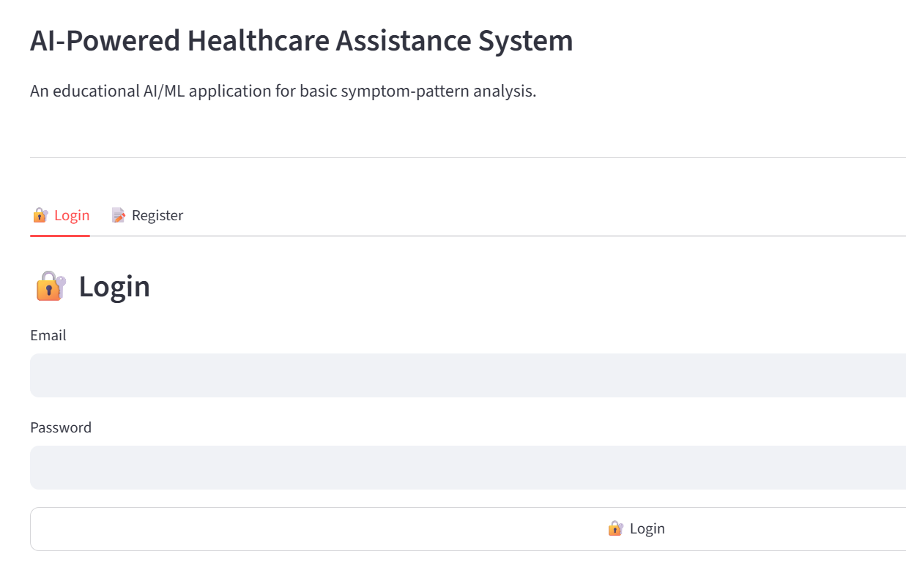
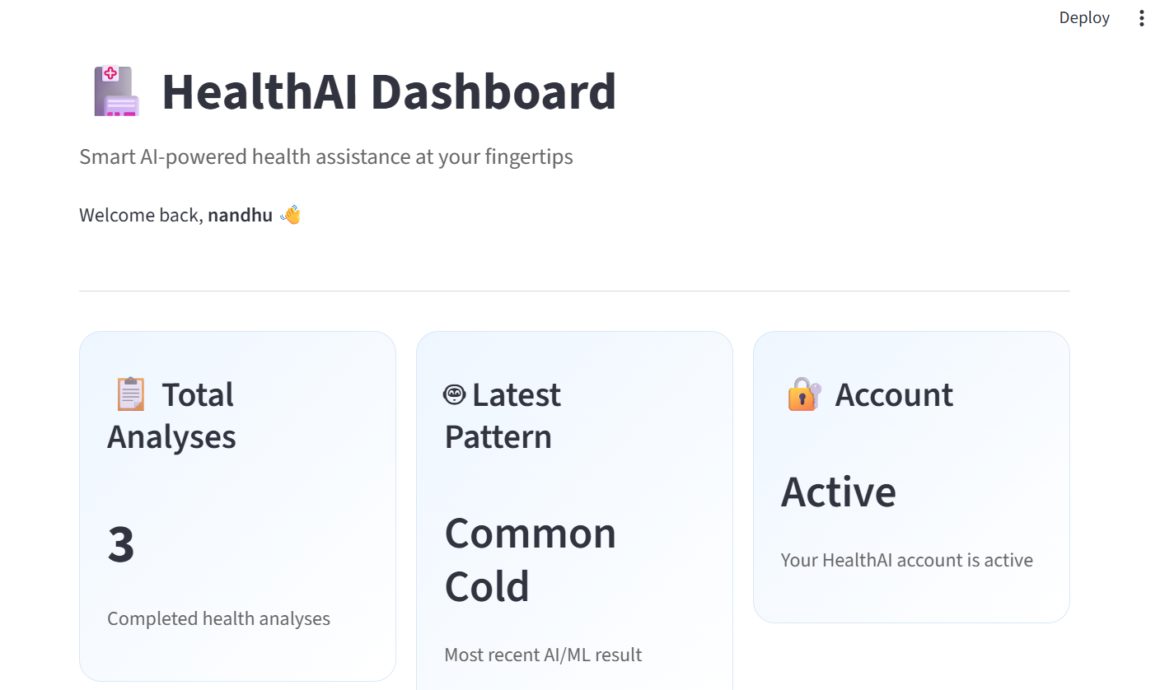
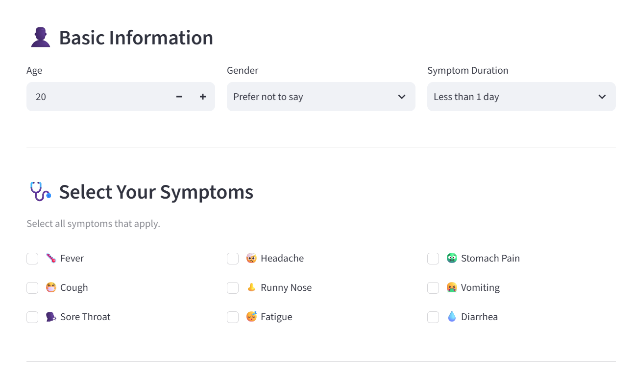
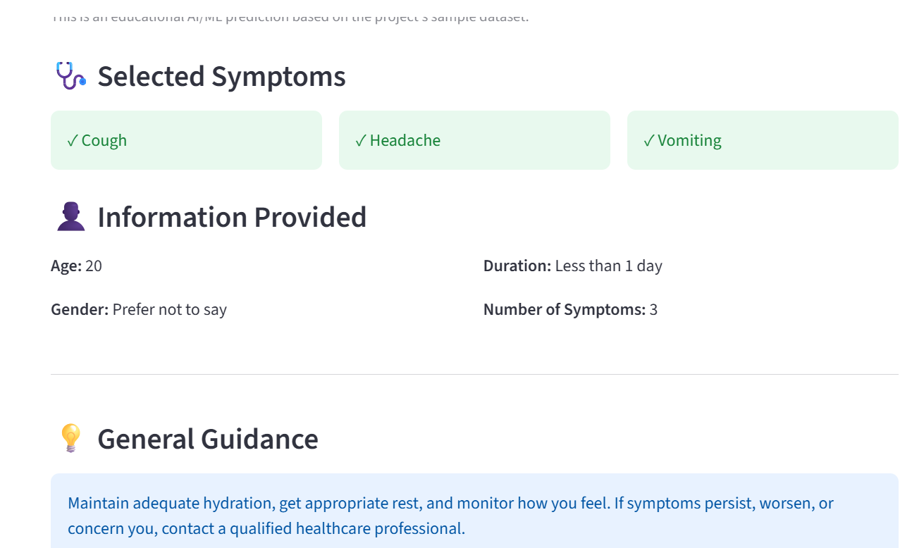
Working Project Screens
Login / Register
Dashboard
Symptom Analyzer
Result & Guidance
HealthAI | AI-Powered Healthcare Assistance System
7

Slide 8
Limitations & Future Enhancements
Limitations
Future Enhancements
Small sample dataset (10 records)
Not clinically validated
JSON storage, basic password hashing
Larger real datasets; compare Random Forest and Naive Bayes with accuracy and recall
Probability / confidence scores
NLP for free-text symptoms; Telugu + English support
SQL database with salted bcrypt hashing
PDF report download; chatbot assistant
Mobile app and cloud deployment
HealthAI | AI-Powered Healthcare Assistance System
8

Slide 9
Conclusion
HealthAI shows how a simple machine-learning model can support basic health awareness through a secure, user-friendly interface. With larger datasets and stronger security it can grow into a more reliable assistant.
This system is for educational purposes and does not replace professional medical advice.
Thank you

